Slide 1
Statistics in Data Science

Slide 2
Topics
Outlier Detection
Five Number Summary
Normal Distribution & Standard Normal Distribution
Z Score
Standardization & Normalization
Permutations & Combinations

Slide 3
Removing the outliers : Five Number Summary
Minimum
First Quartile
Median
Third Quartile
Maximum

Slide 4
Removing the outliers
1,2,2,2,3,3,4,5,5,5,6,6,6,6,7,8,8,9,27
Lower fence = Q1 - 1.5 X IQR
Higher fence = Q3+ 1.5 X IQR
IQR = Q3-Q1
N= 19 (number of observations)
25th percentile = 25/100 X 20 = 5 (index position) i.e. 3
75th percentile =75/100 X 20 = 15 (index) i.e. 7
IQR=Q3-Q1 = 7-3 =4

Slide 5
Removing the outliers
1,2,2,2,3,3,4,5,5,5,6,6,6,6,7,8,8,9,27
Lower fence = Q1 - 1.5 X IQR = 3 - 1.5*4 = -3
Higher fence = Q3+ 1.5 X IQR = 7 + 1.5*4 = 13
Anything > 13 and <-3 is considered as an outlier

Slide 6
Lets remove the outliers from the data from what we have found.
1,2,2,2,3,3,4,5,5,5,6,6,6,6,7,8,8,9,27
1,2,2,2,3,3,4,5,5,5,6,6,6,6,7,8,8,9

Slide 7
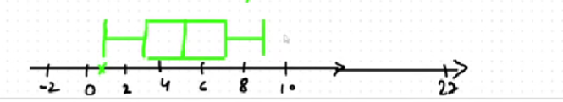
Finding five number summary again
Minimum = 1
First Quartile = 3
Median = 5
Third Quartile = 7
Maximum = 9
Application:
For determining outliers

Slide 8
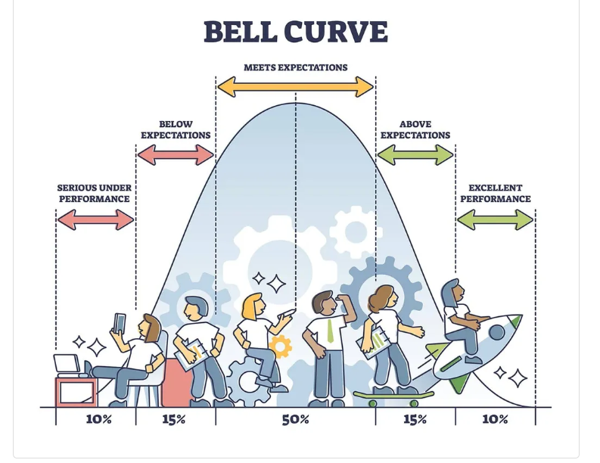
Distribution
Continuous data
Age= {22,34,24,23,21,20,19,18,13,14….}

Slide 9
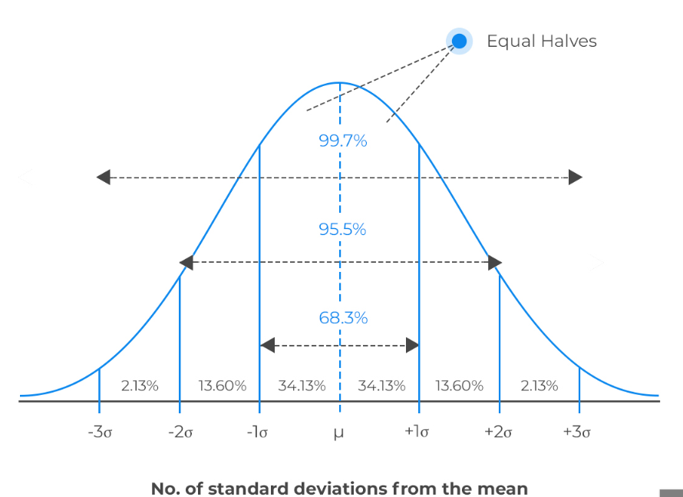
68-95-99.7 % Rule

Slide 10
Example Datasets
Height
Age
Iris dataset

Slide 11
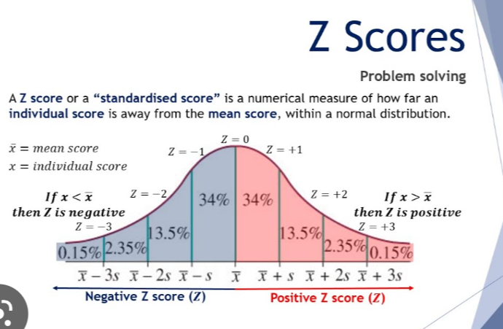

Slide 12
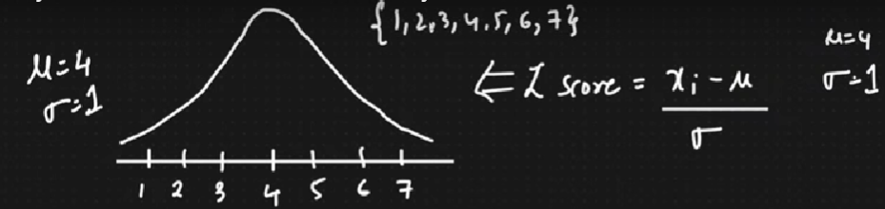
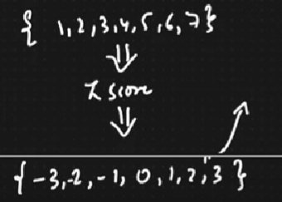
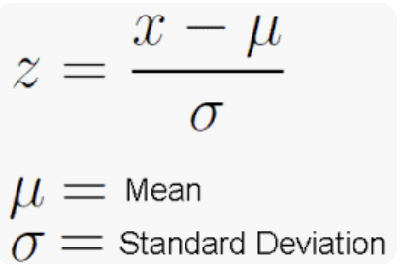

Normal Distribution and Standard Normal Distribution

Slide 13
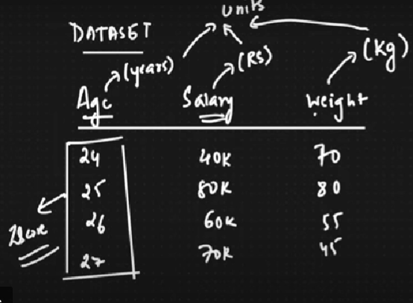
Why to convert a normal distribution into standard normal distribution?

Slide 14
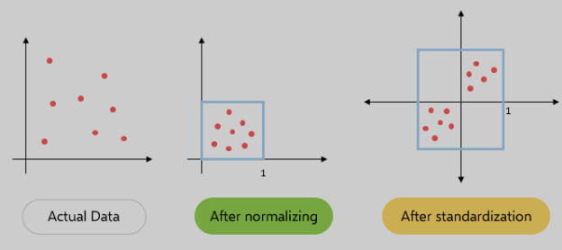
Normalization

Slide 15
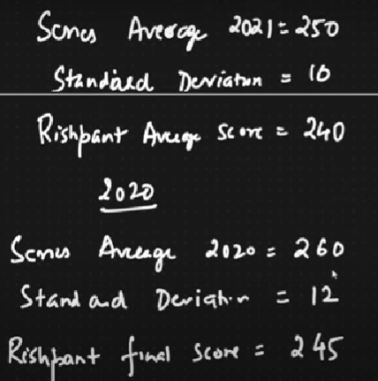
In which year Rishabh Pant played well?

Slide 16
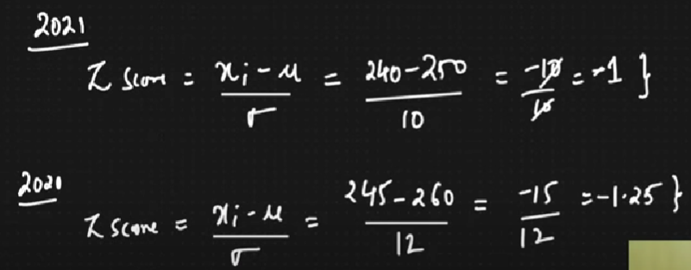
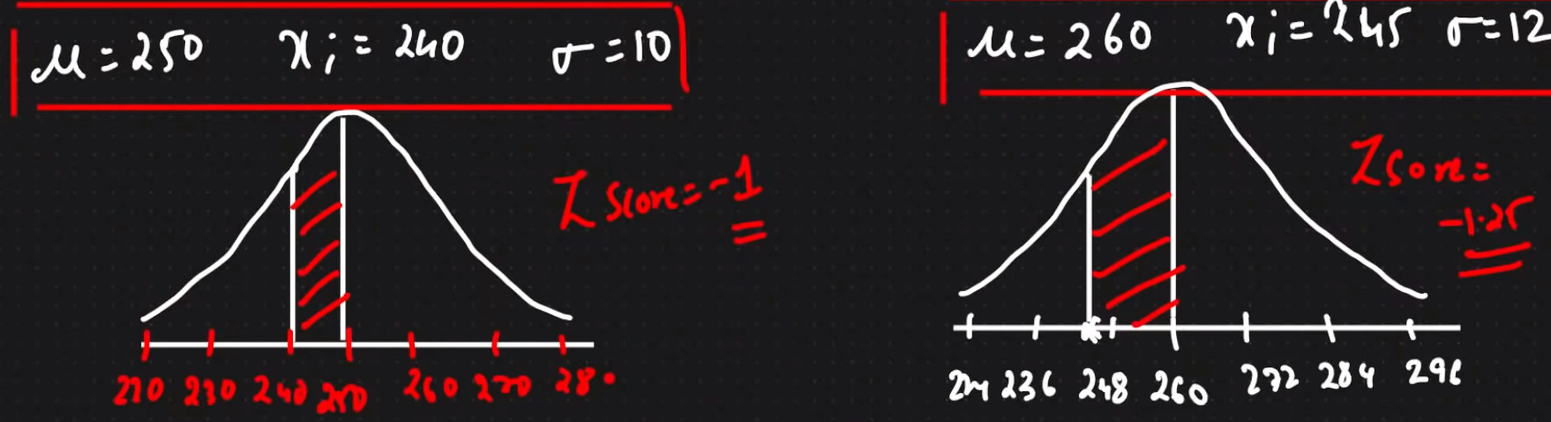

Slide 17
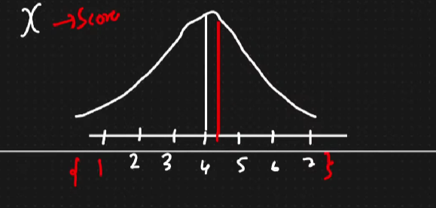
Interview Question
I have a normal distribution. What % of scores fall above 4.25?

Slide 18
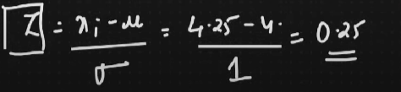
Interview Question
I have a normal distribution. What % of scores fall above 4.25?

Slide 19
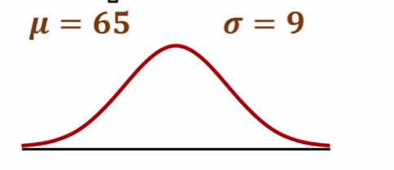
less than 54
atleast 80
between 70 and 86

Slide 20
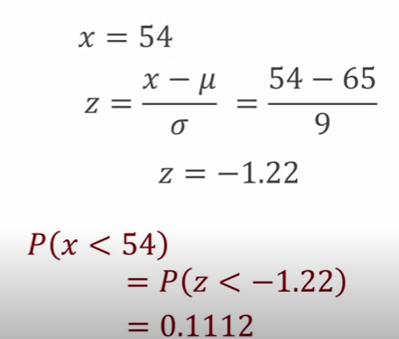
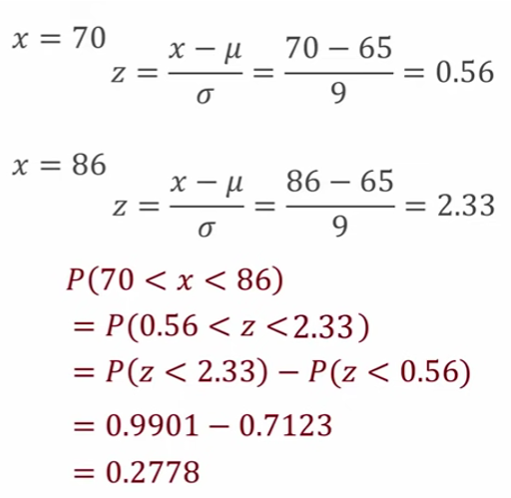
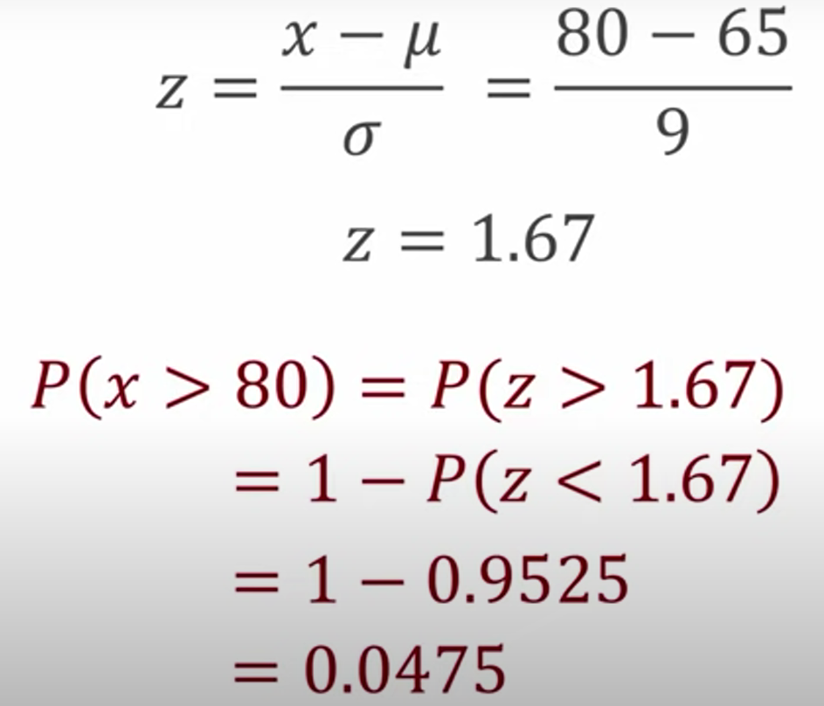
Answers
a)
0.1112
0.0475
0.2778
b)
c)

Slide 21
Interview Questions
In India, the average IQ=100 with a standard deviation of 15? what % of the population would you expect to have an IQ lower than 85?

Slide 22
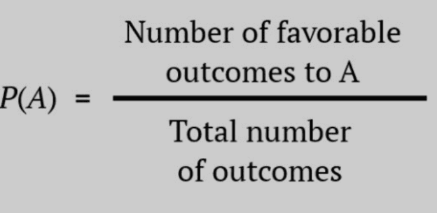
Probability
It is the likelihood of occurrence of an event.
Experiment = Rolling a die
Event = Getting a 6
Find the probability of getting 6?
P(A)= 1/6

Slide 23
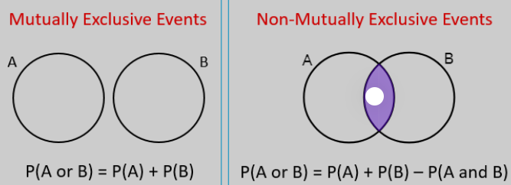
Mutually Exclusive Events
Mutually exclusive events are the events that cannot occur or happen at the same time. In other words, the probability of the events happening at the same time is zero.

Slide 24
Calculating probability
If you toss a coin, what is the probability of the coin landing on a head or a tail?
P(A or B) = P(A) + P(B)
=½ + ½ = 1
P(1 or 3 or 6) = P(1) + P(3) + P(6)
= ⅙ + ⅙ + ⅙

Slide 25
Non-mutual exclusive events: Addition rule
You are picking a card randomly from a desk. What is the probability of choosing a card that is a queen or a heart?
P(Q) = 4/52
P(heart) = 13/52
P(Q and heart) = 1/52
P(Q or heart) = P(Q) + P(heart) - P(Q and heart)
= 4/52 + 13/52 - 1/52 =16/52

Slide 26
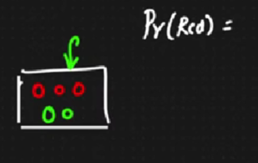
Independent Events : Multiplication Rule
Each and every event is independent of the other events.
Dependent Event: Red marbles and Green marbles

Slide 27
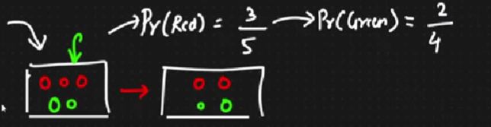
Dependent Events : Multiplication Rule
Each and every event is independent of the other.
Dependent Event: Red marbles and Green marbles (Naive Bayes , Conditional Probability

Slide 28
What is the probability of rolling a 5 and then a 4 in a die?

Slide 29
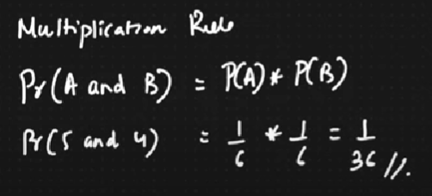
What is the probability of rolling a 5 and then a 4 in a die?
Independent Event

Slide 30
2. What is the probability of drawing a Queen and then an Ace from a deck of cards?

Slide 31
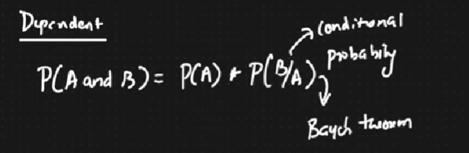
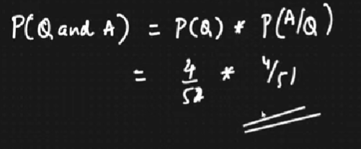
2. What is the probability of drawing a Queen and then an Ace from a deck of cards?

Slide 32
Permutations and Combinations
There are six cars in the factory, write the names of first three cars you see?
—------ —-------- —--------

Slide 33
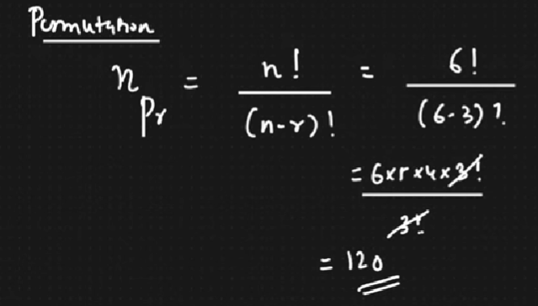
Permutations
There are six cars in the factory, write the names of first three cars you see?
6 5 4
—------ —-------- —--------

Slide 34
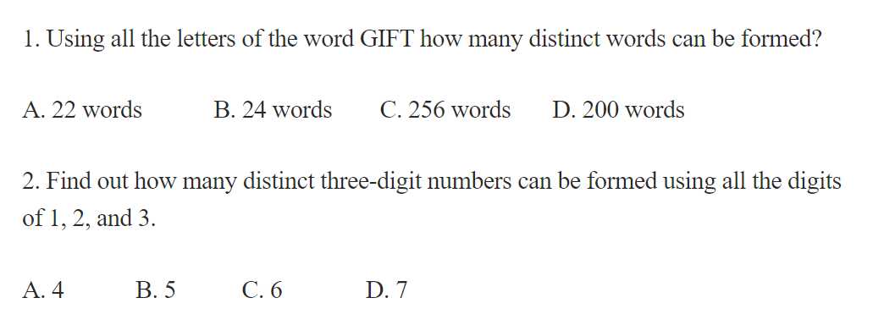
Permutations Questions

Slide 35
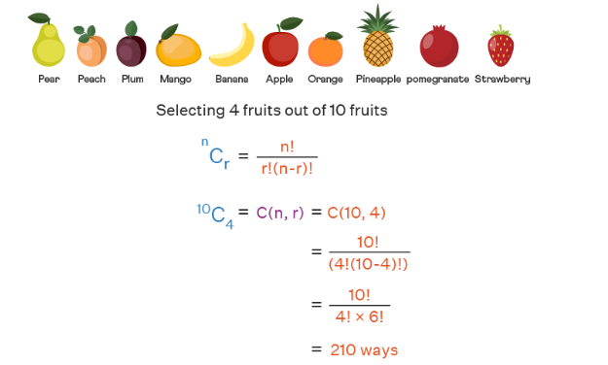
Combinations

Slide 36
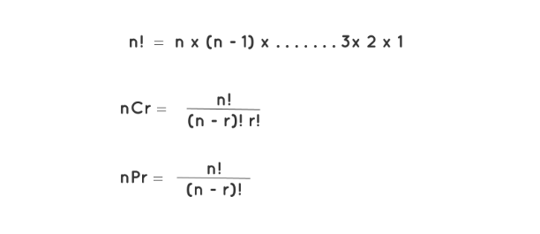
Permutations and Combinations

Slide 37
Combination Questions
How many ways a 6 member team can be formed having 3 men and 3 ladies from a group of 6 men and 7 ladies?
(A) 700
(B) 720
(C) 120
(D) 500

Slide 38
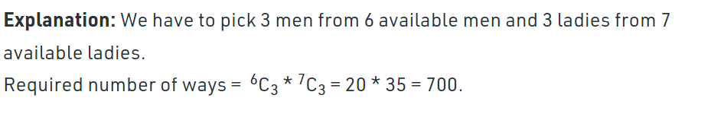
Combination Questions
How many ways a 6 member team can be formed having 3 men and 3 ladies from a group of 6 men and 7 ladies?
(A) 700
(B) 720
(C) 120
(D) 500

Slide 43
